Slide 1
Voltage Stability

Slide 2
Introduction
Maintaining a stable and secure operation of a power system is a very important and challenging issue.
Voltage stability issues are of major concern worldwide. One reason is the significant number of black-outs which have occurred and which frequently have involved voltage stability issues.
Voltage instability phenomena are the ones in which the receiving end voltage decreases well below its normal value and does not come back even after setting restoring mechanisms such as VAR compensators, or continues to oscillate for lack of damping against the disturbances.
“voltage instability stems from the attempt of load dynamics to restore power consumption beyond the capability of the combined transmission and generation system”

Slide 3
Voltage stability in the power system is defined as the ability of a power system to maintain acceptable voltages at all bus in the system under normal condition and after being subjected to a disturbance. In the normal operating condition the voltage of a power system is stable, but when the fault or disturbance occurs in the system, the voltage becomes unstable this result in a progressive and uncontrollable decline in voltage. Voltage stability is sometimes also called load stability.
Due to the voltage instability, voltage becomes uncontrollable in a power system and may undergo voltage collapse, if the post-disturbance equilibrium voltage near loads is below acceptable limits.
Voltage collapse is the process by which the voltage falls to a low, unacceptable value as a result of an avalanche of events accompanying voltage instability.
Voltage collapse may leads to total or partial blackout.

Slide 4
CAUSES OF VOLTAGE COLLAPSE
Load on the transmission lines is too high.
Voltage sources are too far from the load centers.
Source voltages are too low.
Large distances between generation and load.
Poor co-ordination between various control and protective systems.
Insufficient load reactive compensation.
PREVENTION OF VOLTAGE COLLEPSE
Application of reactive power compensating devices
Control of network voltage and generator reactive o/p
Co-ordination of protection / controls
Control of transformer tap changers
Undervoltage load shedding
Stability margin
Spinning reserve

Slide 5
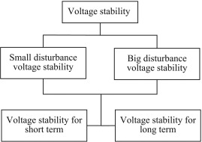
Classification of Voltage Stability

Slide 6
Small disturbance voltage stability :
It refers to a system’s ability to keep the voltage within an acceptable range when experiencing disturbances, such as load rising by a small amount.
Both load characteristics and influences of continuous and discontinuous control can affect the small disturbance voltage stability. Automatic voltage regulators, excitation systems, turbine and governor dynamics fall in this short-term or ‘transient’ time scale, which is typically a few seconds.
Induction motors, electronically operated loads and HVDC interconnections also fall in this category. The concept of small disturbance stability is related to steady state and be analyzed using a small-signal model of the system.

Slide 7
Large disturbance voltage stability:
It refers to the ability to keep the bus voltage within an acceptable range when experiencing disturbances such as losing the generator, short circuit, line outage, or system failure.
System characteristics, load characteristics, as well as the control and protection of the two combined, can determine large disturbance voltage stability. Components operating in the long-term time frame are transformer tap changers, limiters, boilers etc. Typically, this time frame is for a few minutes to tens of minutes.
Large disturbance voltage studies can be studied by using non-linear time domain simulations which include proper modeling.
Voltage stability can be divided into long-term voltage stability and short-term voltage stability, according to their period and time length.

Slide 8
Comparison between rotor angle stability and voltage stability
Rotor angle stability | Voltage stability
1. Concerned with ability of power system to maintain synchronism when subjected to sudden disturbance. | 1. Concerned with ability of a power system to maintain acceptable voltages at all bus in the system under normal condition and after being subjected to a disturbance.
2. Basically a generator stability. | 2. Basically a load stability.
3. Concerned with integrating remote power plant to a large system over long transmission lines. | 3. Concerned with load area and load characteristics.
4. May also involve voltage collapse. | 4. May or may not involve rotor angle stability.
5. 5. Angle stability mainly depends on the balance between real power generation and demand. | 5. Voltage stability depends on the balance of reactive power demand and generation in the system
6. Rotor angle problem arise during and after fault. | 6. Voltage stability problem arise mainly in the event of faults.

Slide 9


Voltage Stability Limit
The voltage stability limit can be defined as the limiting stage in a power system beyond which no amount of reactive power injection will raise the system voltage to its nominal state. The system voltage can only be adjusted by reactive power injections till the system voltage stability is maintained.
The power transfer over a lossless line is given by:
where P = power transferred per phase V_{s} = sending-end phase voltage V_{r} = receiving-end phase voltage X = transfer reactance per phase δ = phase angle between V_{s} and V_{r}.
Since the line is lossless:

Slide 10
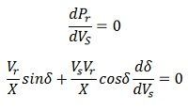


Assuming the power generation to be constant,
For maximum power transfer: δ = 90º, so that as tanδ→∞
Above equation gives the location of the critical point on the δ versus V_{s} curve. It is assumed that the receiving end voltage is constant.
The Similar result can be obtained assuming the sending end voltage constant and analyzing the system taken V_{r} as a variable parameter. In this case, the resultant equation is

Slide 11







The reactive power expression at the receiving-end bus may be written as
Therefore,
On substituting the value of dδ/dVr from equation, we get
or,

Slide 12

At the steady-state power angle stability, δ = 90º so that as δ→∞
Above equation represents steady-state voltage stability limit. It shows that, at steady state stability limit, the reactive power becomes infinite. This means that dQ/dV_{r} becomes zero. Hence the rotor angle stability limit under steady state conditions is coincident with steady state voltage stability limit. The voltage stability at steady state is also affected by the load.

Slide 13
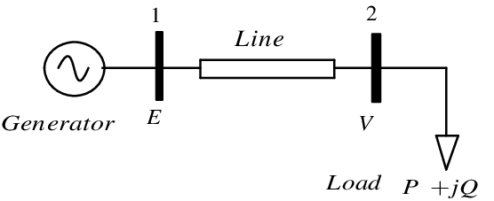
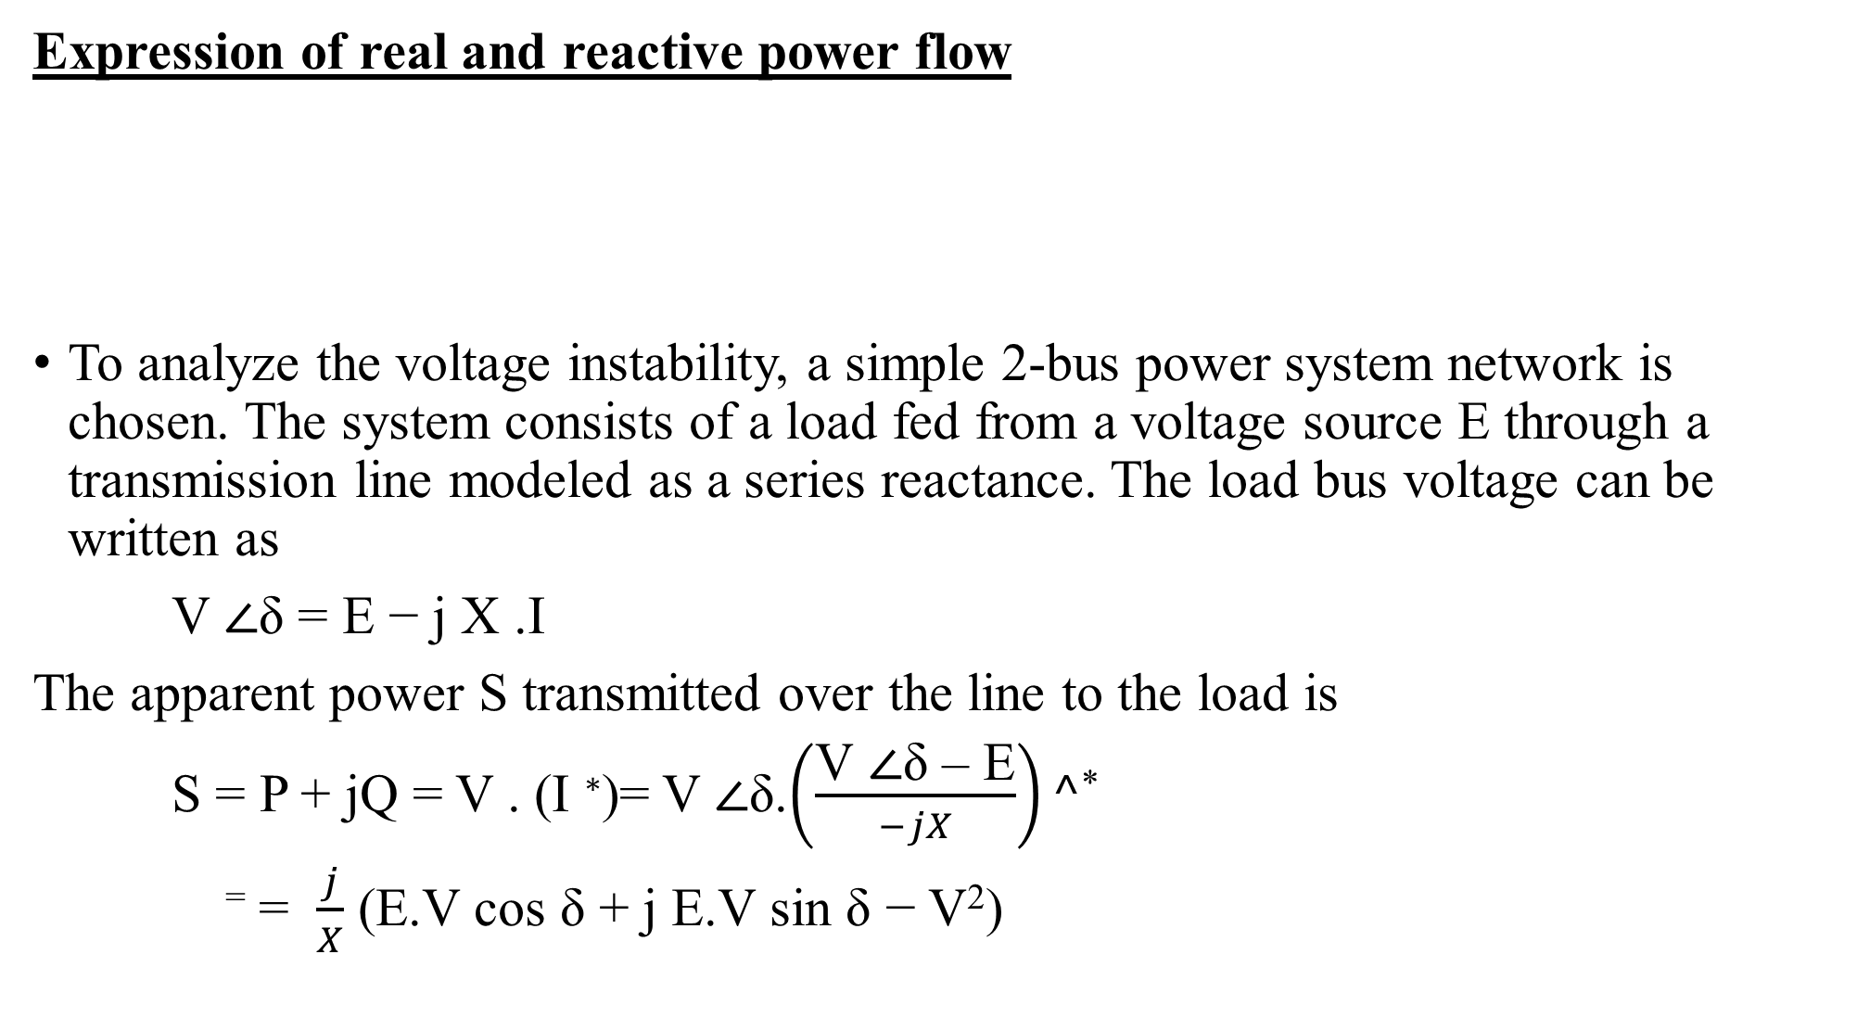
Expression of real and reactive power flow
To analyze the voltage instability, a simple 2-bus power system network is chosen. The system consists of a load fed from a voltage source E through a transmission line modeled as a series reactance. The load bus voltage can be written as
V ∠δ = E − j X .I
The apparent power S transmitted over the line to the load is
S = P + jQ = V . (I ∗)= V ∠δ.$\left(\frac{\text{V}\text{ ∠}\text{δ}\text{ – }\text{E}}{−jX}\right)^\text{∗}$
⁼ = $\frac{j}{X}$ (E.V cos δ + j E.V sin δ − V²)

Slide 14
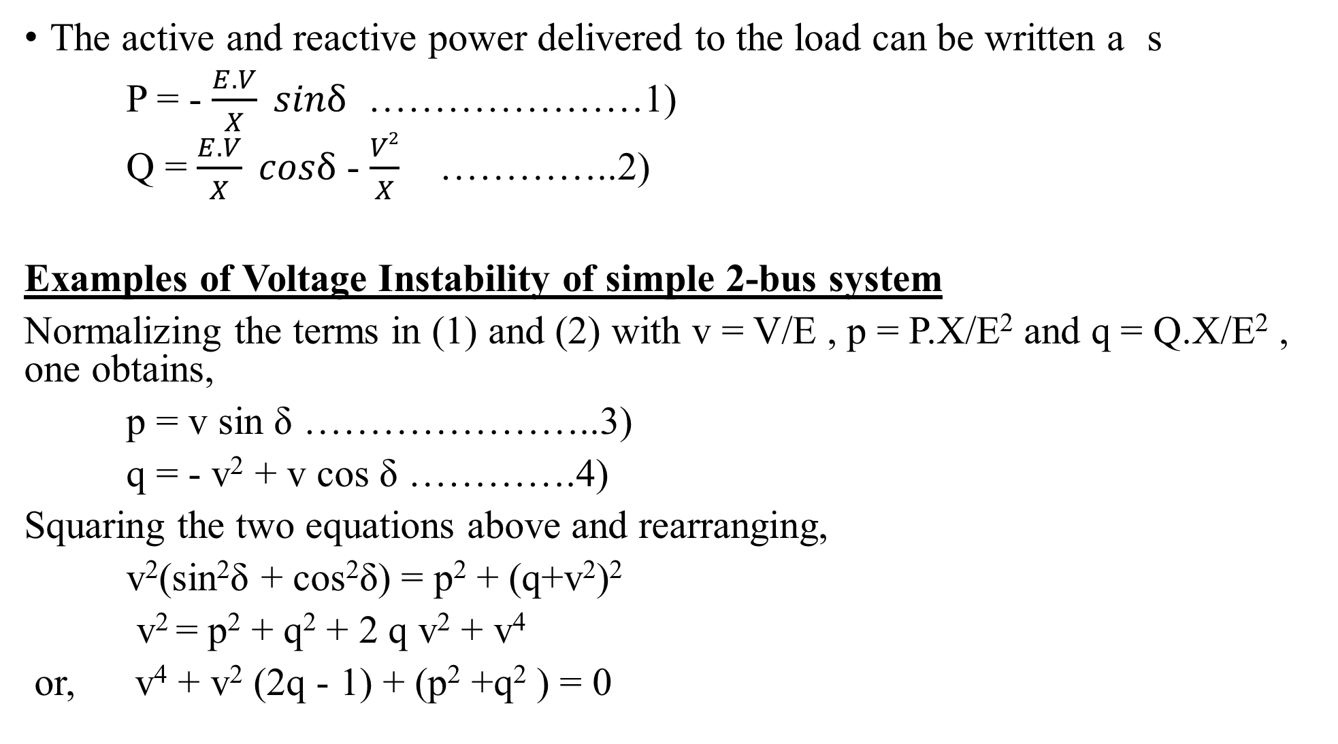
The active and reactive power delivered to the load can be written a s
P = - $\frac{E.V}{X} sinδ$ …………………1)
Q = $\frac{E.V}{X} cosδ$ - $\frac{V2}{X}$ …………..2)
Examples of Voltage Instability of simple 2-bus system
Normalizing the terms in (1) and (2) with v = V/E , p = P.X/E² and q = Q.X/E² , one obtains,
p = v sin δ …………………..3)
q = - v² + v cos δ ………….4)
Squaring the two equations above and rearranging,
v²(sin²δ + cos²δ) = p² + (q+v²)²
v² = p² + q² + 2 q v² + v⁴
or, v⁴ + v² (2q - 1) + (p² +q² ) = 0

Slide 15
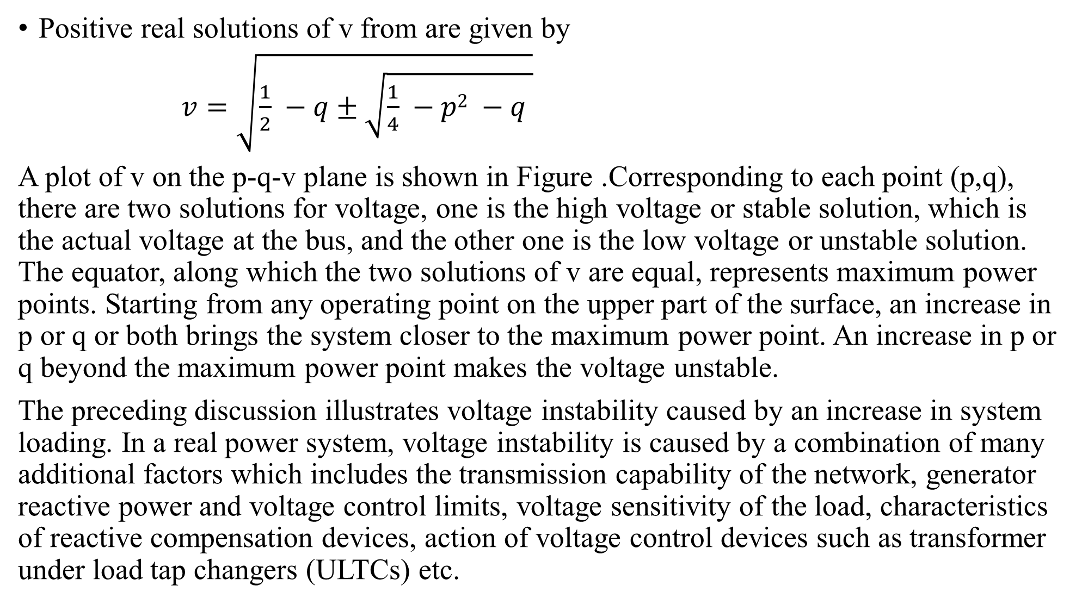
Positive real solutions of v from are given by
$v=\sqrt{\frac{1}{2} −q±\sqrt{\frac{1}{4} −p2 −q }}$
A plot of v on the p-q-v plane is shown in Figure .Corresponding to each point (p,q), there are two solutions for voltage, one is the high voltage or stable solution, which is the actual voltage at the bus, and the other one is the low voltage or unstable solution. The equator, along which the two solutions of v are equal, represents maximum power points. Starting from any operating point on the upper part of the surface, an increase in p or q or both brings the system closer to the maximum power point. An increase in p or q beyond the maximum power point makes the voltage unstable.
The preceding discussion illustrates voltage instability caused by an increase in system loading. In a real power system, voltage instability is caused by a combination of many additional factors which includes the transmission capability of the network, generator reactive power and voltage control limits, voltage sensitivity of the load, characteristics of reactive compensation devices, action of voltage control devices such as transformer under load tap changers (ULTCs) etc.

Slide 16
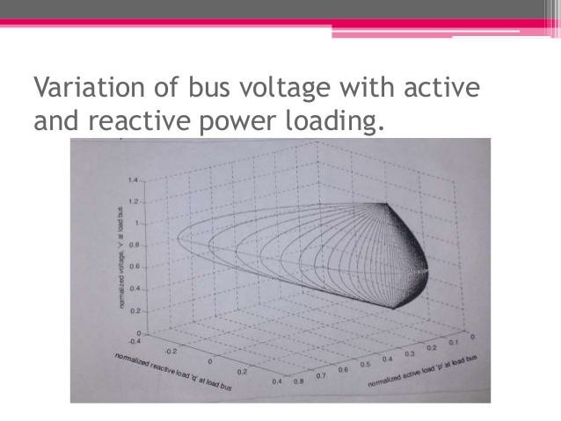

Slide 17
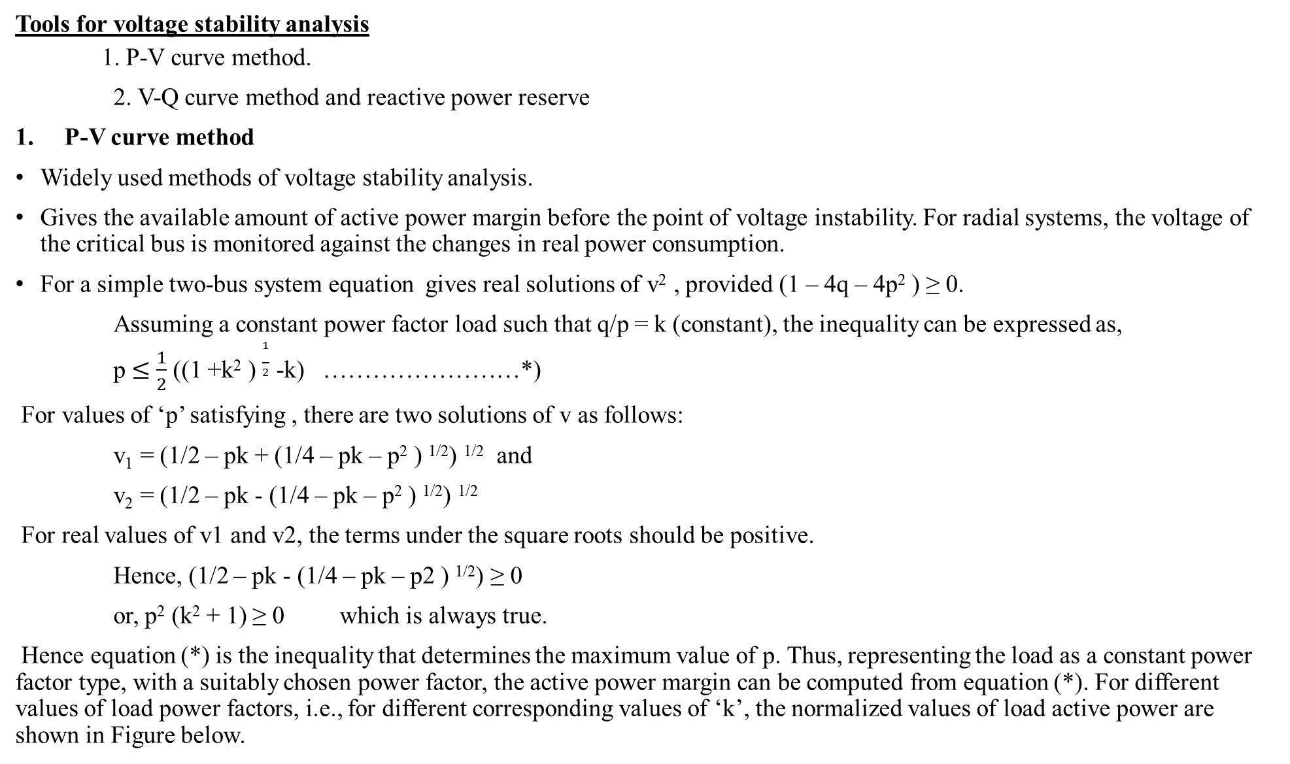
Tools for voltage stability analysis
1. P-V curve method.
2. V-Q curve method and reactive power reserve
P-V curve method
Widely used methods of voltage stability analysis.
Gives the available amount of active power margin before the point of voltage instability. For radial systems, the voltage of the critical bus is monitored against the changes in real power consumption.
For a simple two-bus system equation gives real solutions of v² , provided (1 – 4q – 4p² ) ≥ 0.
Assuming a constant power factor load such that q/p = k (constant), the inequality can be expressed as,
p $≤$ $\frac{1}{2}$ ((1 +k² ) $\frac{1}{2}$ -k) ……………………*)
For values of ‘p’ satisfying , there are two solutions of v as follows:
v₁ = (1/2 – pk + (1/4 – pk – p² ) ^{1/2}) ^{1/2} and
v₂ = (1/2 – pk - (1/4 – pk – p² ) ^{1/2}) ^{1/2}
For real values of v1 and v2, the terms under the square roots should be positive.
Hence, (1/2 – pk - (1/4 – pk – p2 ) ^{1/2}) ≥ 0
or, p² (k² + 1) ≥ 0 which is always true.
Hence equation (*) is the inequality that determines the maximum value of p. Thus, representing the load as a constant power factor type, with a suitably chosen power factor, the active power margin can be computed from equation (*). For different values of load power factors, i.e., for different corresponding values of ‘k’, the normalized values of load active power are shown in Figure below.

Slide 18
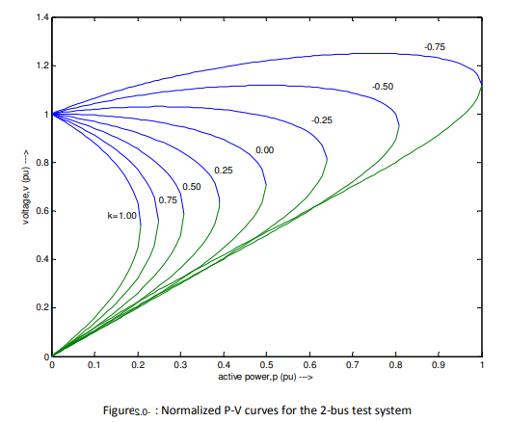

Slide 19
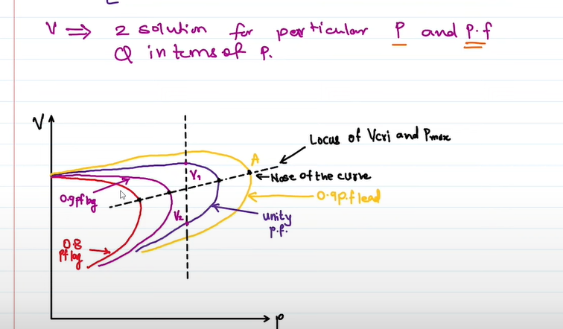
Upper zone from axis is voltage stable zone and lower is unstable zone

Slide 20
Figure shows that as the load on the system is increases, system moves towards voltage collapse point. Before reaching voltage collapse point, there exist several equilibrium points of operation. After crossing the load ability limit, system collapses as equilibrium is lost.
Thus, For P-V curves, describe relation between nose of curve and maximum loadability.

Slide 21
2. V-Q curve method and reactive power reserve
Another possibility to demonstrate the capacity of the small system is to show the V-Q relation.
The necessary amount of reactive power in the load end for a desired voltage level V at that bus is plotted
Voltage security of a bus is closely related to the available reactive power reserve, which can be easily found from the V-Q curve of the bus under consideration. The reactive power margin is the MVAR distance between the operating point and either the nose point of the V-Q curve or the point where capacitor characteristics at the bus are tangent to the V-Q curve [1].
Stiffness of the bus can be qualitatively evaluated from the slope of the right portion of the V-Q curve. The greater the slope is, the less stiff is the bus, and therefore the more vulnerable to voltage collapse it is. Weak busses in the system can be determined from the slope of V-Q curve.
For a range of values of voltage and different active power levels, normalized V-Q curves are shown in Figure

Slide 22
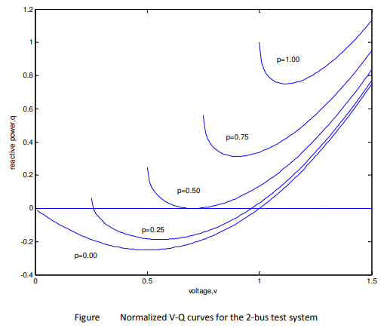
The critical point or nose point of the characteristics corresponds to voltage where dQ/dV becomes zero. If the minimum point of the V-Q curve is above the horizontal axis, then the system is reactive power deficient. Additional reactive power sources are needed to prevent a voltage collapse.
In Figure below, curves for p=1.00 and p=0.75 signify reactive power deficient busses. Busses having V-Q curves below the horizontal axis have a positive reactive power margin. The system may still be called reactive power deficient, depending on the desired margin.

Slide 23
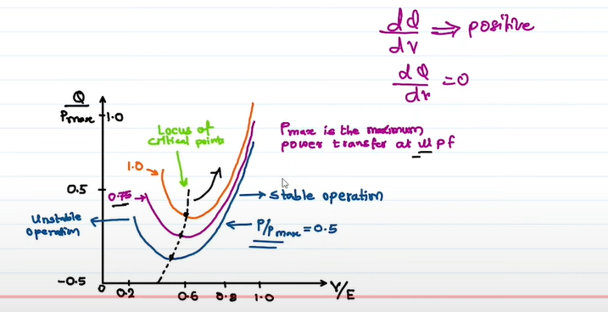

Slide 24
Generation Capability Curve
Generator Capability Curves of the synchronous generator tells about the limits in which a generator can continue its operation without any damage. It also recognized as the functioning chart of the synchronous generator.
Capability Curve of a Synchronous Generator defines a boundary within which the machine can operate safely i.e. reflects the maximum active and reactive power that a synchronous generator can deliver at its terminals.
Active power delivered by generator is only limited by the power delivering capability of turbine. But the reactive power which a generator can deliver continuously without over heating is governed by three limits:
i) Armature Current Limit,
ii) Field Current Limit and
iii) End Part Heating Limit

Slide 25
Armature Current Limit
Armature current is the load current in the stator winding. Let the armature current is I. This current will lead to heating of stator winding due to ohmic loss I²R in the resistance of stator winding. This means that, a constraint is put by the limit of cooling of generator stator winding. Ideally there is a balance between the heat produced by I²R loss and cooling of stator winding. But if the heating of stator winding is more than its cooling then it will lead to excessive heating and consequent damage to armature of generator.
Therefore the armature current of Generator shall not exceed the design maximum value. Let’s us now try to plot this armature current limit on P-Q plane.
As we know that complex power is given as
P+jQ = VI* where I* is conjugate of I.
= VI(CosØ + jSinØ)
Taking modulus to both sides, we get
P² + Q² = (VI)² which is an equation of circle with center at origin and of radius VI as shown below.

Slide 26
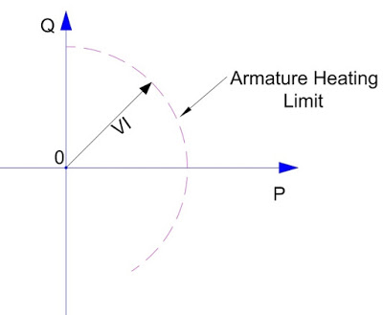
The above circle represent the armature current heating limit on generator operation. Generator shall always be operated under the circle to avoid heating.

Slide 27
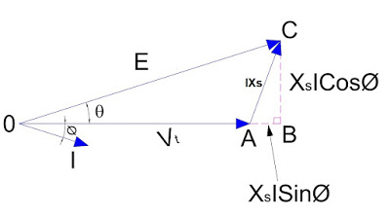
Field Current Limit
A maximum limit on the value of field current is imposed by the heating in the field winding due to I_{f}²R loss where R is the resistance of field winding. This means that generator can only supply / absorb a fixed maximum value of reactive power. We know that, E = V_{t} + jIX_{s}
where E is no load excitation voltage, V_{t} is terminal voltage, I is load current and X_{s} is synchronous impedance of Generator. The above equation can be represented by the phasor as shown below.
From the above phasor,
X_{s}ICosØ = ESinθ
⇒ ICosØ = (ESinθ) / X_{s}…………………………. (1)
X_{s}ISinØ = ECosθ – V_{t}
⇒ ISinØ = [(ECosθ) / X_{s}] – (V_{t} / X_{S})……………………………(2)

Slide 28
Now, active and reactive power delivered by Generator can be calculated as
P = V_{t}ICosØ
= (EV_{t}Sinθ) / X_{s} …….[from equation (1)]
⇒ P = (EV_{t}Sinθ) / X_{s} …………….(3)
Note that the above equation of active power is not new one rather it is very famous equation where θ is load angle.
Q = V_{t}ISinØ
= (EV_{t}Cosθ) / X_{s} –V_{t}²/X_{s}…….[from equation (2)]
⇒ (Q + V_{t}²/X_{s}) = (EV_{t}Cosθ) / X_{s} ……..(4)
Squaring (3) and (4) and then adding we get,
P² + (Q + V_{t}²/X_{s})² = (EV_{t} / X_{s})²
Assuming generator terminal voltage V_{t} and synchronous impedance X_{s} to be constant, the variable in the above equation is only E and we know that E a Air gap flux. Air gap flux is directly proportional to field current I_{f}. Hence this equation represents the locus of field current.
The above equation is the equation of circle having centre at (0 , – V_{t}²/X_{s}) and radius (EV_{t} / X_{s}). This circle is shown below.

Slide 29
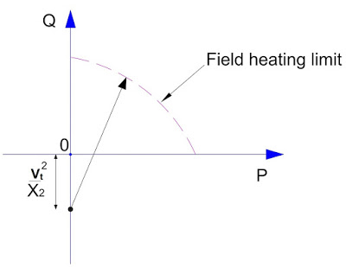
The above circle represents the field heating limit. Generator must be operated within this circle to avoid field heating.

Slide 30
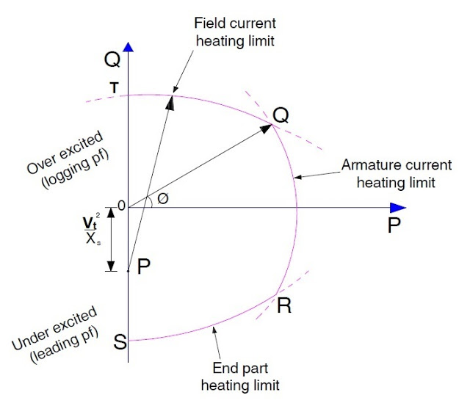
End Part Heating
End part heating puts a limit on generator reactive power when machine is operating under leading power factor condition. Leading power factor means, the machine is under excited, therefore field current will increase to meet the required working flux. This will cause more end flux in the machine which will link with the stator lamination to cause eddy current heating.
Till now we have discussed the three constraints on generator reactive power capability. It’s now time to sum up the three constrains to get the Capability Curve of Generator. The Capability Curve of Generator is shown below.

Slide 31
SUMMARY
Following points can be observed and noted from the capability curve:
1) Armature heating and field heating limits are shown by curve QR and QT respectively. Both these curve cut at point Q which means the generator shall be operated at this point under lagging load condition.
2) End part heating is shown by curve RS for leading load condition. It shall be noted that armature heating limit and end part heating limit curves cut each other at point R. This point is the point of operation of generator under leading load condition.
3) Generator operation shall always be confined within the capability curve at all the time else it may damage due to overheating.
4) Capability Curve is supplied by the manufacturer and works as a guideline for operator of generator.
5) Capability Curve is all about heating of different parts. This means that if the cooling of machine is increased then the limits of generator operation will also increase. This means the individual limits will increase and the operation boundary will broaden.

